Slide 1

Project 1 Standardized Test Analysis
Edmund
Ethan
Emma
Tiek Leong
Kah Fei
Notes:
Emma

Slide 2
Problem Statement
We are a team of data scientists tasked by the California Department of Education to explore factors and gaps that contribute to different ACT and SAT participation rates across the counties in California.
Notes:
emma

Slide 3
Contents
Overview & trends on participation rate from 2017 to 2019
Factors
GDP per Capita
Household Income
Poverty Level
Education Expenditure
Crime Rate
Unemployment Rate
Conclusion and recommendations
Notes:
emma

Slide 4
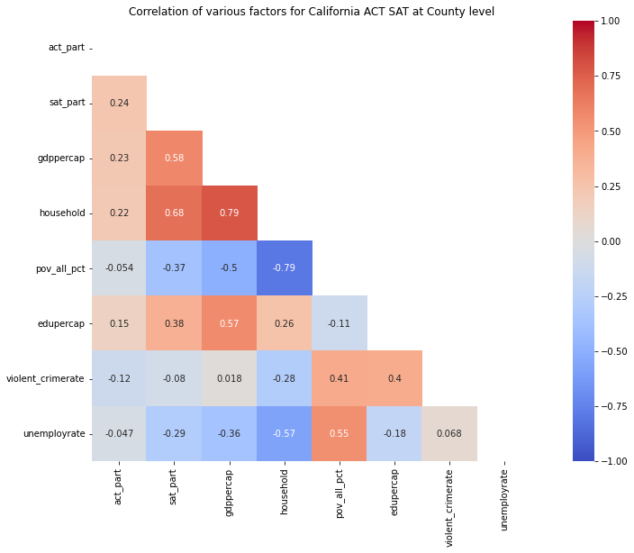
Correlation of various factors to test participation rates
Heatmap showing the correlation of various factors to test participations
Factors
GDP per capita
1
Household Income
2
Factors with relatively higher correlation with participation rates
Poverty Level
3
Discussed next slides
Education Expenditure
Crime Rate
Unemployment Rate
ACT participation rate
SAT participation rate
Notes:
emma

Slide 5
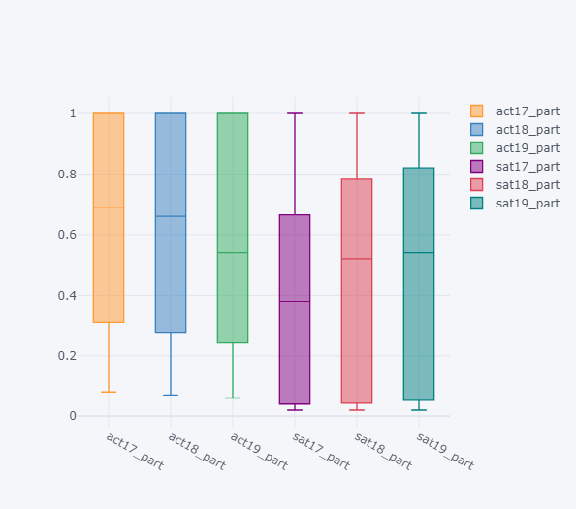
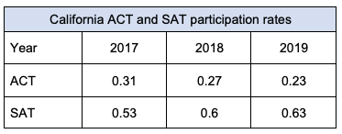
ACT and SAT participation trend across US states (2017-2019)
Boxplot showing test participation quartiles and trend from 2017-2019
ACT 2017
ACT 2018
ACT 2019
SAT 2017
SAT 2018
SAT 2019
At states level, the ACT participation rate is showing a downward trend from 2017 to 2019 and the SAT participation rate is rising.
The same goes to California where the ACT participation rates has declined and SAT participation rate increases.
This could suggest that support for the SAT test is beginning to rise across US, including California.
ACT 2017
ACT 2018
ACT 2019
SAT 2017
SAT 2018
SAT 2019
Notes:
Tiek leong

Slide 6
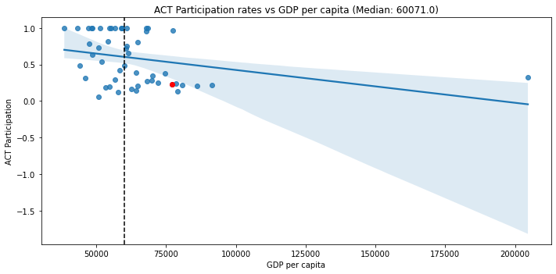
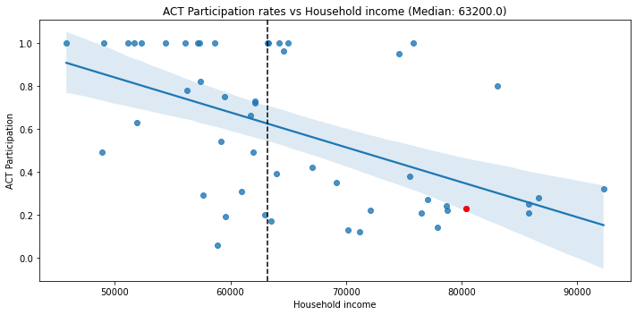
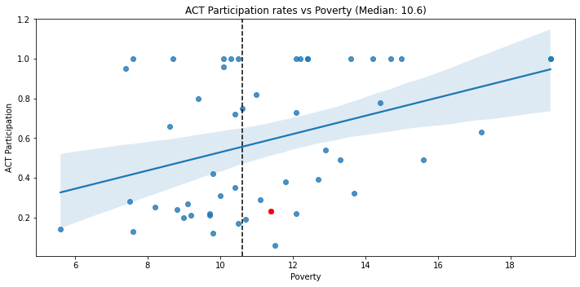
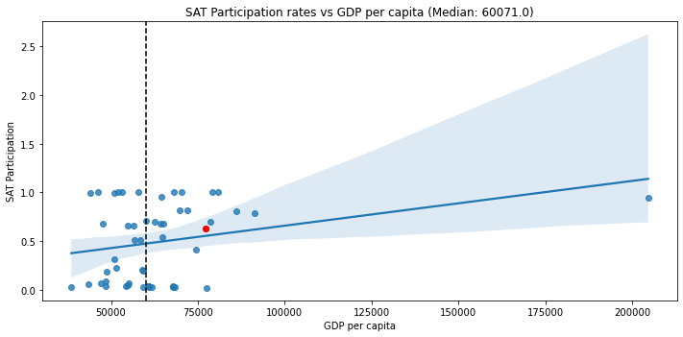
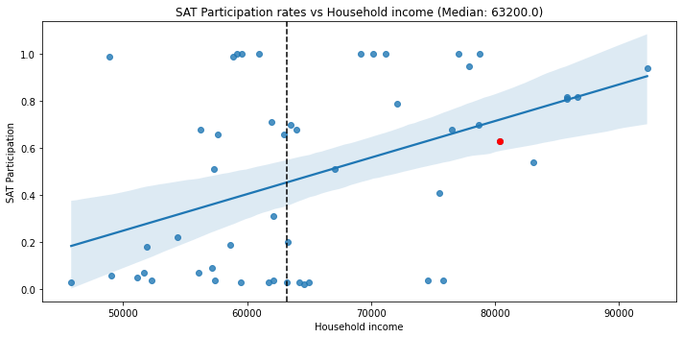
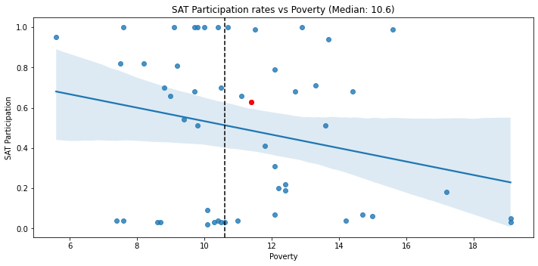
Visualization of GDP per Capita, Household Income and Poverty Level vs Test Participation at National level
GDP per Capita vs
ACT participation
Household Income vs ACT participation
Poverty Level vs
ACT participation
GDP per Capita vs
SAT participation
Household Income vs SAT participation
Poverty Level vs
SAT participation
*Vertical dotted line in plots shows the median value of the respective factors
Notes:
Tiek leong

Slide 7
Factor 1: GDP per capita

Slide 8
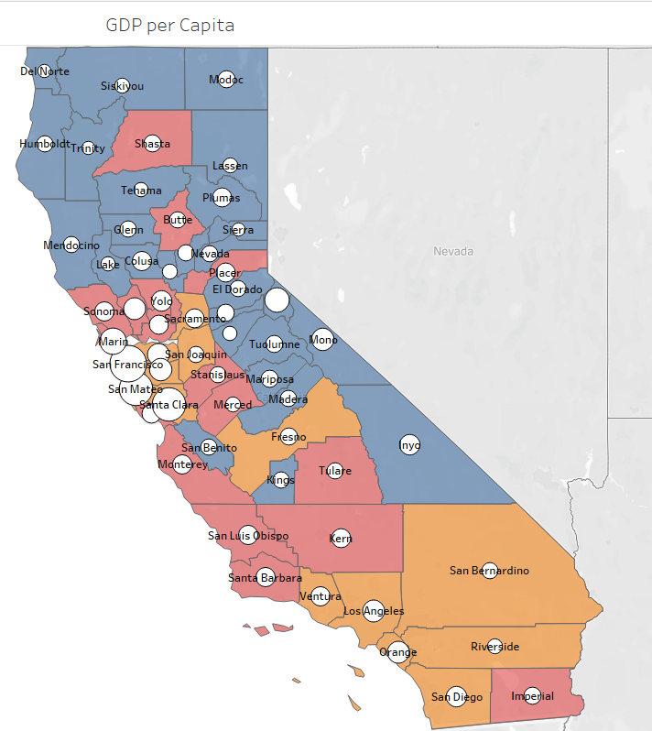

GDP per Capita in California Counties
Counties classification of California
Counties with Highest GDP per Capita
Caucuses
County | GDP/Cap (USD) | Caucus
San Francisco | 199k | Urban
Santa Clara | 167k | Urban
San Mateo | 162k | Urban
Marin | 103k | Suburban
Alpine | 90k | Rural
Rural
Suburban
Urban
By California State of Association of County
Counties with Lowest GDP per Capita
County | GDP/Cap (USD) | Caucus
Tehama | 31k | Rural
Lake | 29k | Rural
Sierra | 27k | Rural
Trinity | 26k | Rural
Del Norte | 26k | Rural
Notes:
Kah fei

Slide 9
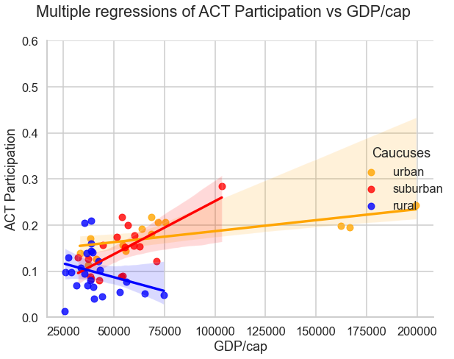
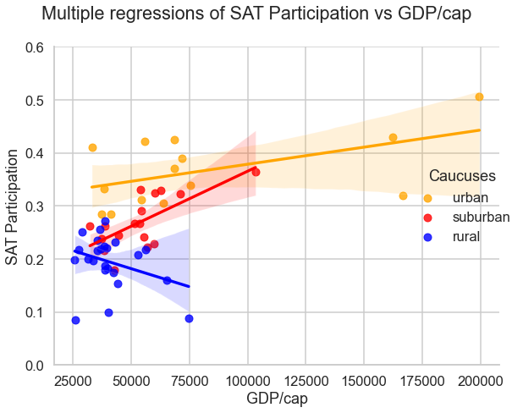
GDP per Capita as a factor for Test participation rates
ACT Participation
SAT Participation
R = 0.49
R = 0.57
Overall participation in SAT > ACT by 42.86%
Positive participation trend versus GDP per capita for Urban and Suburban counties
Rural counties shows different trend
Urban > Suburban > Rural
Notes:
Kah fei
For urban and suburban counties which have higher GDP , the students are more likely to take part on the tests. This suggested that the awareness and establishness of educational system is better.
This can be taken as one of the clue for CDE to design the actions to increase the overall participation rate.
But for the rurals, we believe there is others factors to be considerate, which will discuss later in this presentation

Slide 10
Factor 2: HOUSEHOLD INCOME

Slide 11
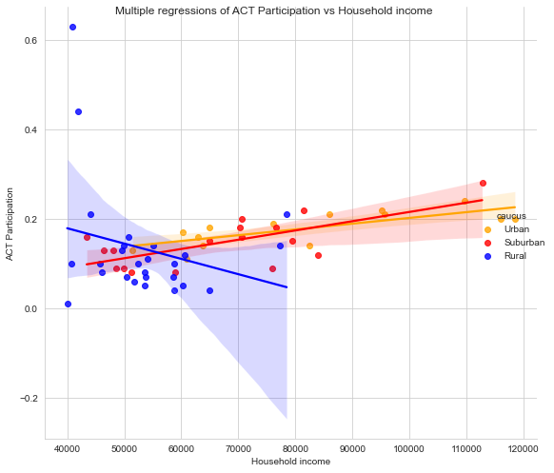
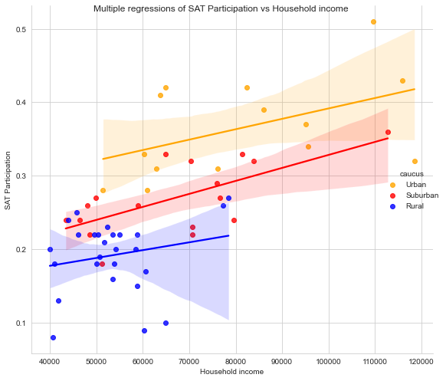
Household income as a factor for Test participation rates
ACT Participation
SAT Participation
R = 0.22
R = 0.68
For ACT, there is a negative correlation for Rural counties with a higher participation rate and lower household income.
Conversely, Suburban and Urban counties display a positive correlation between household income and SAT participation rate
Overall, correlation is moderately positive at 0.68
All three caucuses display a positive trend between household Income and SAT Participation rate.
Notes:
Edmund

Slide 12
Factor 3: POVERTY

Slide 13
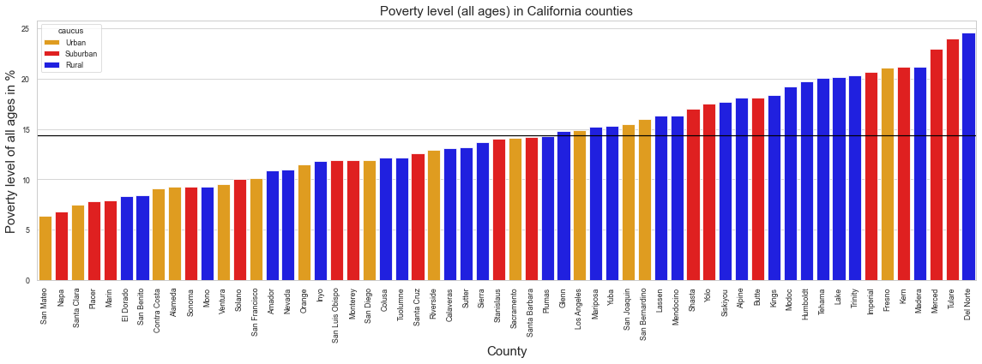
Poverty level for all ages in California by counties
Mean Value = 14.37%
County with lowest level of poverty:
San Mateo (6.4%)
County with highest level of poverty:
Del Norte (24.6%)

Slide 14
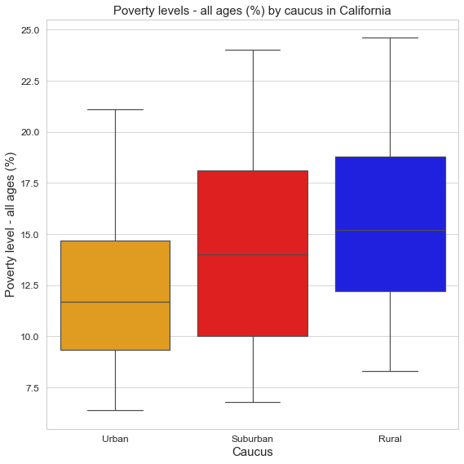
Poverty level for all ages in California by counties
County with highest level of poverty:
Del Norte (24.6%)
Urban counties tend to have lower poverty levels while rural counties tend to have higher poverty levels.
Suburban counties have a wider range, as there are counties with low and high poverty levels closer to both ends of the spectrum
County with lowest level of poverty:
San Mateo (6.4%)

Slide 15
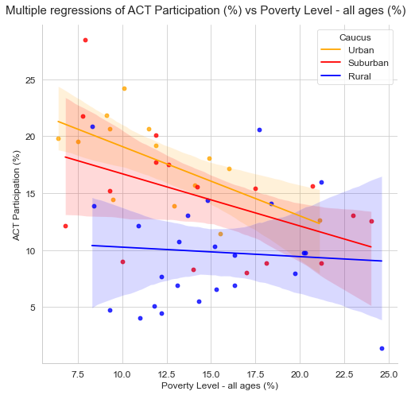
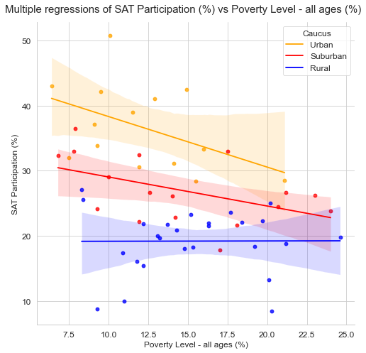
Poverty level as a factor for Test participation rates
ACT Participation
SAT Participation
R = -0.38
R = -0.37
Moderate and negative correlation
All three regression lines sloping downwards
Poverty levels in Urban counties have the strongest effect on ACT test participation, followed by Suburban and Rural counties
Moderate and negative correlation
Two regression line sloping downwards, one flat
Similar to ACT, poverty levels in Urban counties have the strongest effect on SAT test participation, followed by Suburban and Rural counties

Slide 16
Factor 4: EDUCATION EXPENDITURE PER CAPITA

Slide 17
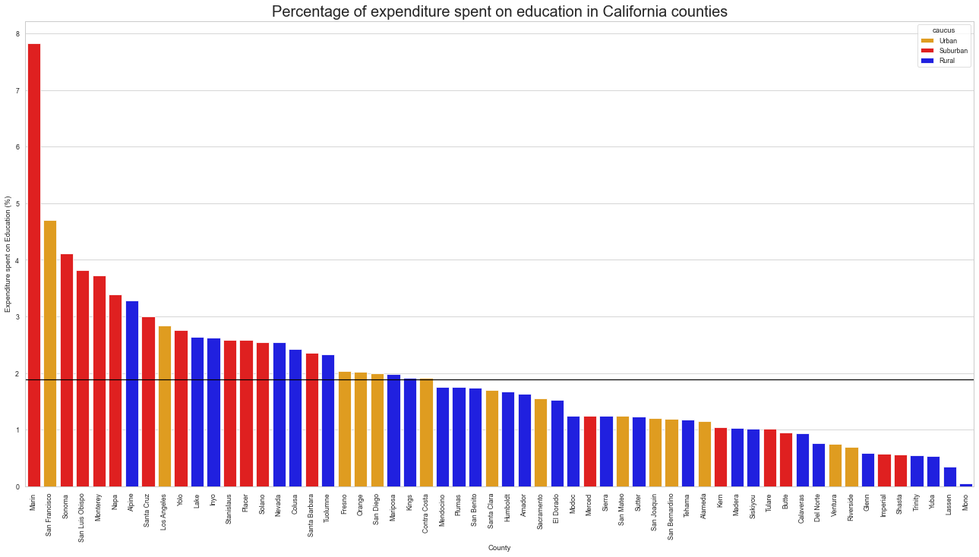
Education Expenditure per Capita (%) in California by counties
Mean Value = 14.37%
Mean Value = 1.89%
County with highest %:
Marin (7.83%)
County with lowest level %:
Mono (0.05%)
Notes:
Let us take a look at the percentage of expenditure each county spends on education. From the above chart, we are able to see that majority of the suburban caucus allocates a higher percentage compared to the urban and rural caucus.

Slide 18
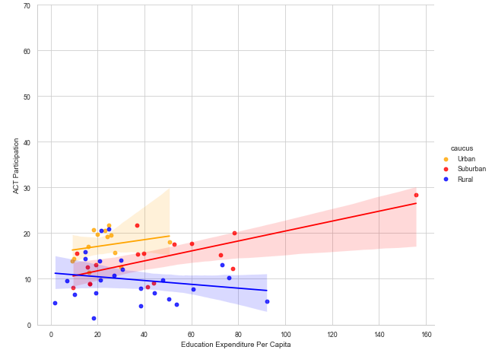
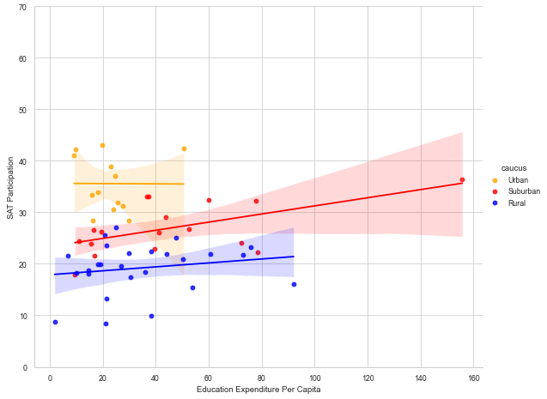
Education Expenditure per Capita as a factor for Test Participation
ACT Participation
SAT Participation
R = 0.18
R = 0.08
Low and positive correlation
Two regression line sloping upwards, one sloping downwards
Education expenditure per capita levels in Suburban counties have the strongest effect on ACT test participation, followed by Urban and Rural counties
Low and positive correlation
Two regression line sloping upwards, one flat
Similar to ACT, Education expenditure per capita levels in Suburban counties have the strongest effect on SAT test participation, followed by Rural and Urban counties
Notes:
With the highest allocation of expenditure on education in the suburban caucus, we can see that it is reflected in the strong positive correlation of the education expenditure per capita for both ACT and SAT tests.
The higher the allocation of education expenditure, the higher the participation rate in SAT and ACT tests in the suburban caucuses.
The opposite trend is observed in the rural caucuses, where a higher percentage of allocated education expenditure does not mean a higher participation rate in ACT tests.

Slide 19
Factor 5: CRIME RATE

Slide 20
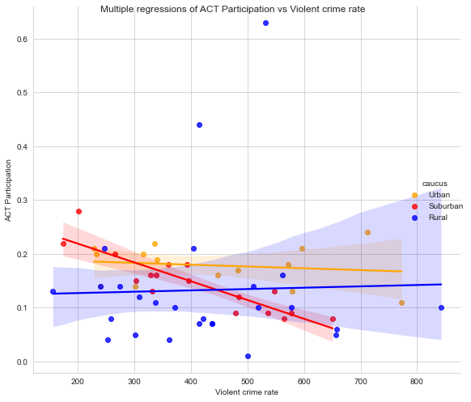
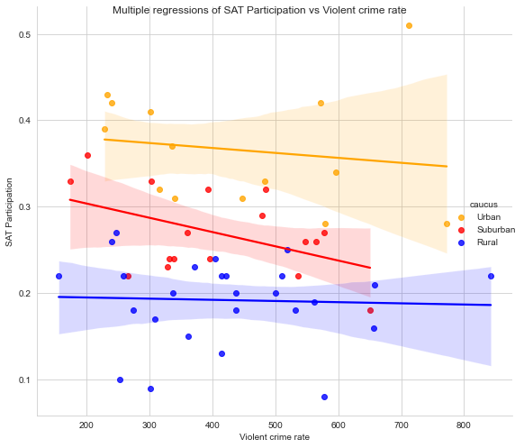
Violent crime rate as a factor for Test participation rates
ACT Participation
SAT Participation
R = -0.12
R =-0.08
There is almost no correlation between violent crime and ACT test participation for Urban and Rural counties
There is a negative correlation for Suburban counties where when violent crime increases, the participation rate tend to decrease
There is slight negative correlation to no correlation between violent crime rate and SAT test participation for rural counties while there is a negative correlation for Urban and suburban counties
Notes:
More studies should be done to focus on how violent crime rate negatively affects test participation and if this relationship more prevalent if we focus on juvenile violent crime rate.

Slide 21
Factor 6: UNEMPLOYMENT RATE

Slide 22
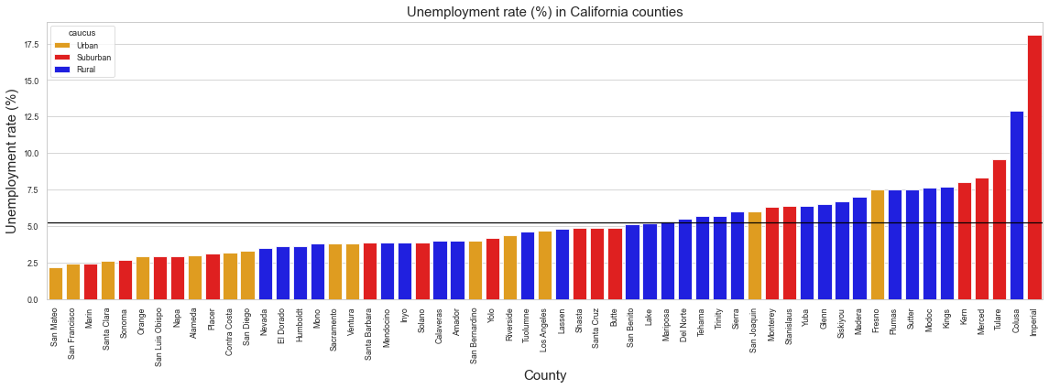
Unemployment rate in California by counties
Mean Value = 5.24%
County with lowest unemployment rate:
San Mateo (2.2%)
County with highest unemployment rate:
Imperial (18.1%)

Slide 23
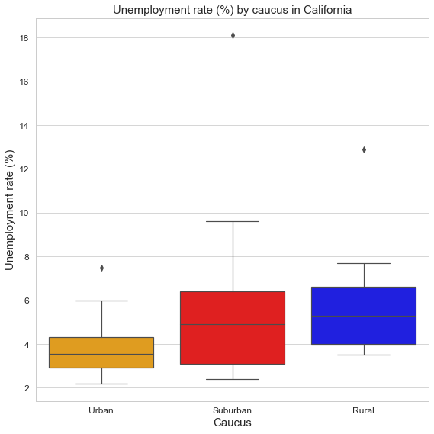
Unemployment rate in California by counties
County with highest unemployment rate:
Imperial (18.1%)
Urban counties tend to have lower unemployment rates while suburban and rural counties tend to have higher unemployment rates
Outliers are circled in red, defined as greater than Q3 + 1.5x the interquartile range
County with lowest unemployment rate:
San Mateo (2.2%)

Slide 24
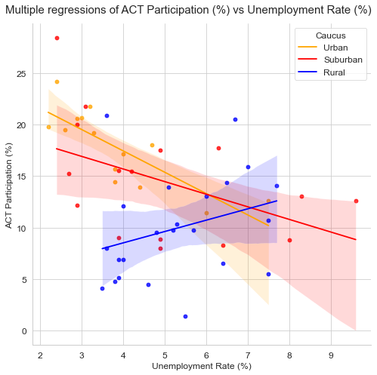
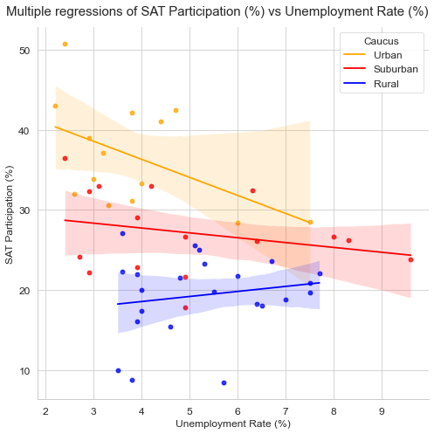
Unemployment rate as a factor for Test participation rates
ACT Participation
SAT Participation
R = -0.36
R = -0.38
Moderate and negative correlation
Two regression line sloping downwards, one sloping upwards
Unemployment rate in Urban areas have the strongest effect on ACT test participation, followed by Suburban and Rural areas
Moderate and negative correlation
Two regression line sloping downwards, one sloping upwards
Similar to ACT, unemployment rate in Urban areas have the strongest effect on SAT test participation, followed by Suburban and Rural areas

Slide 25
Summary of all factors & Recommendations

Slide 26
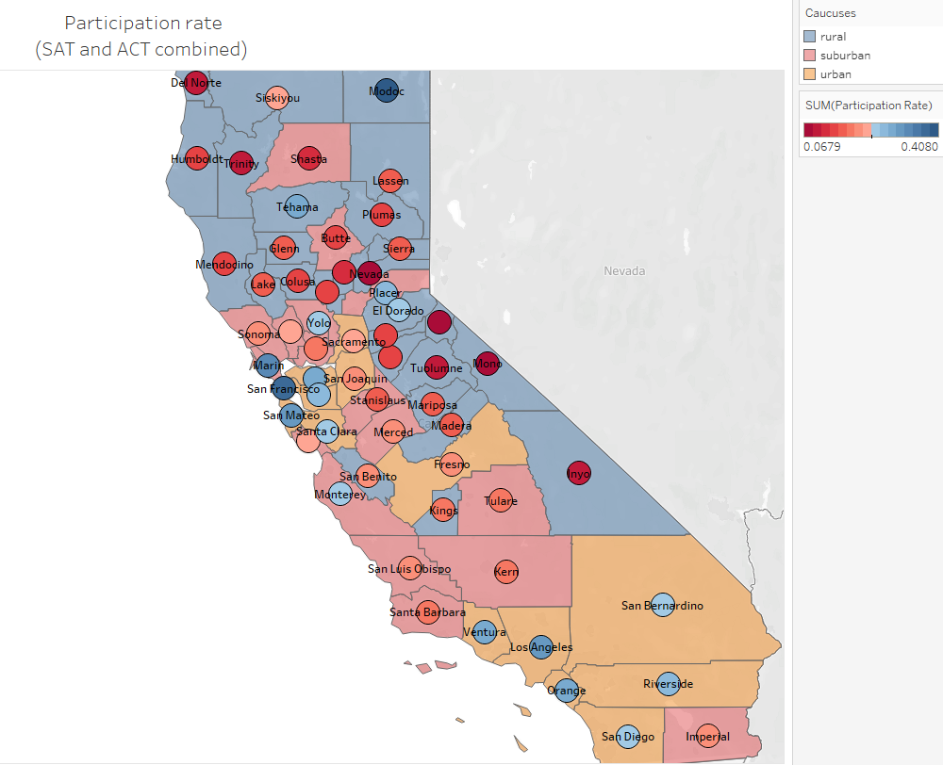
Summary of all factors
Factors | Correlation with Participation Rate
 | ACT | SAT
GDP per Capita | 0.49 | 0.57
Household Income | 0.22 | 0.68
Poverty | -0.38 | -0.37
Education Expenditure | 0.18 | 0.08
Crime Rate | -0.12 | -0.08
Unemployment Rate | -0.36 | -0.38
Combined test participation rate across California
Caucuses
Rural
Suburban
Urban
The participation rate of ACT and SAT test in California is strongly positively associated with GDP per capita and household income and it is negatively associated with poverty level and unemployment rate.
However, some of the trends are not reflective of Rural counties which might be due to reasons such as cultural norms or geography (not covered in this study).
To increase participation rates, we will recommend tackling factors with higher correlation, as per highlighted in green in the table above.
Combined test participation rate (%)
6.8
40.8
Notes:
edmund

Slide 27
Recommendations to increase test participation rates
To tackle any financial disadvantages among population:
Increase percentage of budget allocated for education for each county
Provide free/subsidized preparation courses and test for low-income students to raise participation rates
Introduce scholarship programs for students in counties with lower GDP per capita and household income to pursue higher education
To tackle any social inequality:
Work with the related departments or parties to promote high quality jobs and to raise standards of living in all counties, instead of just Rural or Suburban counties
Notes:
Kah fei

Slide 28
THANK YOU! Any questions?

